Slide 1
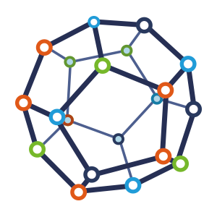


Computer Network
Class VI
lab 4

Slide 2
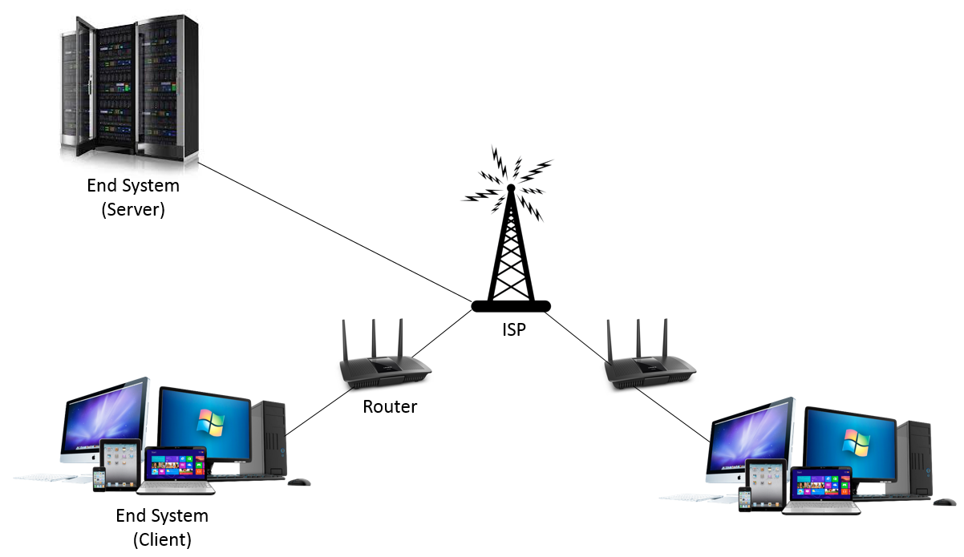
Computer Networks
Setting up a computer network is a fast and reliable way of sharing information and resources

Slide 3
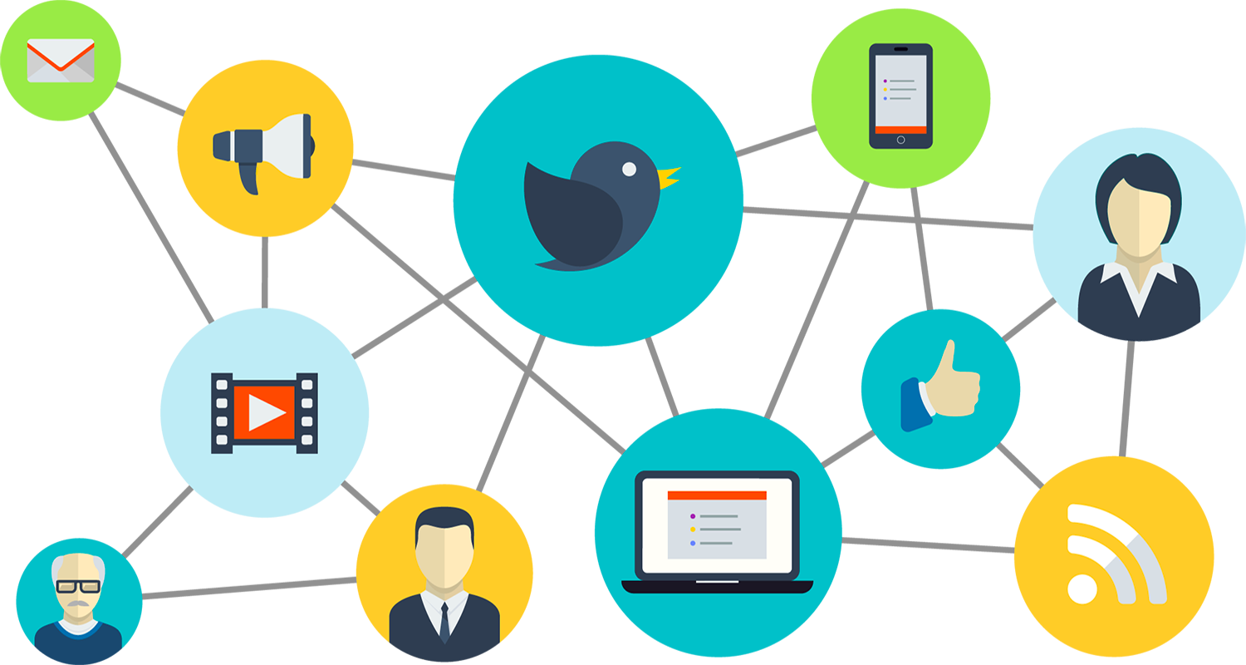
Advantages of computer networking
File sharing
Resource sharing
Sharing a single internet connection
Increasing storage capacity

Slide 4
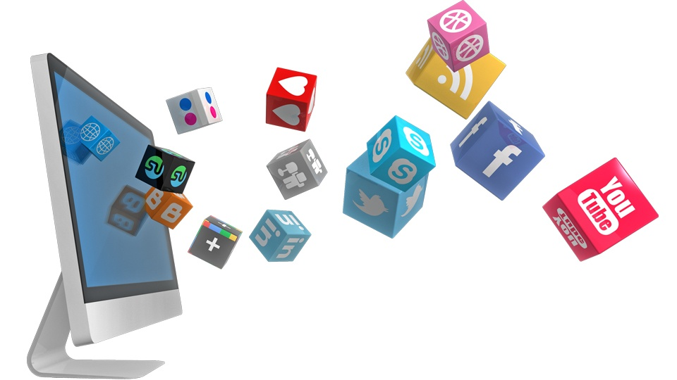
File sharing
you can easily share data between different users, or access it remotely if you keep it on other connected devices.

Slide 5
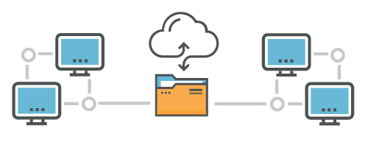
Resource Sharing
using network-connected peripheral devices like printers, scanners and copiers, or sharing software between multiple users, saves money

Slide 6
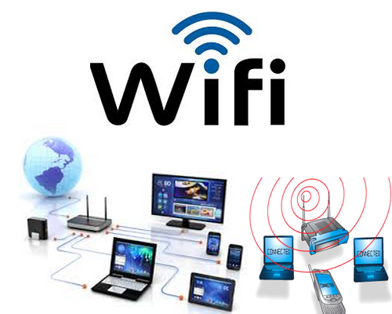
Sharing Internet Connection
sharing internet over wifi is a pretty good choice

Slide 7
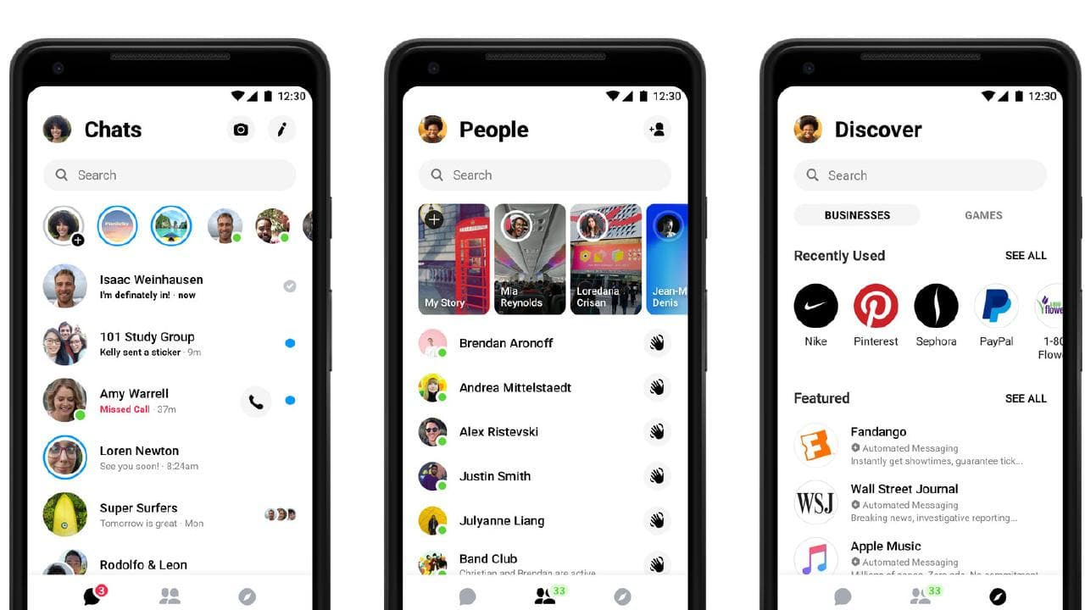

Chatting & Video Conferencing

Slide 8



